Slide 1
Pre-Bid Meeting for Daytime Expressway Sweeping 80D51

Slide 2
Description of Project
Full Expressway Cleaning Cycle and Supplemental Sweeping shall consist of the pickup, removal and satisfactory disposal of limbs, sticks, leaves, sand, stones, dirt, weeds, debris, deceased animal carcasses, refuse, Litter and any other rubbish which has accumulated on the highway areas located on various State maintained expressway routes located within the counties of Cook, DuPage, Lake and Will.

Slide 3
Prosecution Of Work
The contractor shall understand before bidding that the schedule of starting, and completion dates will be determined during the preconstruction meeting and may be revised to align with the Department’s operational needs. No minimum or maximum quantity of any pay item work is guaranteed.
Interim Completion Dates
Work Order Schedule
Expressway Cycle: 80 working days.
Supplemental: 2 working days
Liquated Damages: $2,300.00
Contract Completion Date: 12/31/27
1ST Cycle Monday April 5th, 2027
2ND Cycle Monday September 13th, 2027

Slide 4
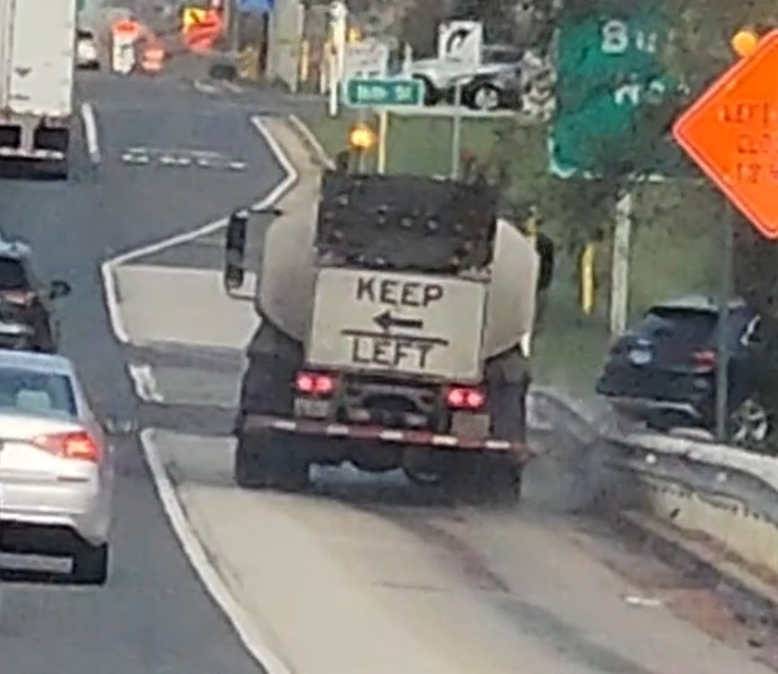
Performance Of Work
Sweeper Speed Limits
Disposal of Waste
At no time shall the sweeping unit and any related vehicles in the sweeping train exceed 15 miles per hour in speed while performing any work.
Removal and disposal of all waste and deceased animal carcasses collected during the prosecution of this work will be the responsibility of the Contractor and will be disposed of by the Contractor at his expense
No Flushing
Flushing shall not be used for cleaning under and behind guardrail or to clean the shoulders. Waste shall not be flushed outside of the area to be cleaned. All water Truck should have down facing nozzles as to not move debris outside of the cleaning area.
Dry Sweeping
Sweeping will not proceed if temperatures are forecasted by the Department’s consulting meteorologists to drop below 32°Dry sweeping shall be allowed only if it is considered an emergency, immediate hazard, or any work as designated by the Department that requires priority corrective action.

Slide 5
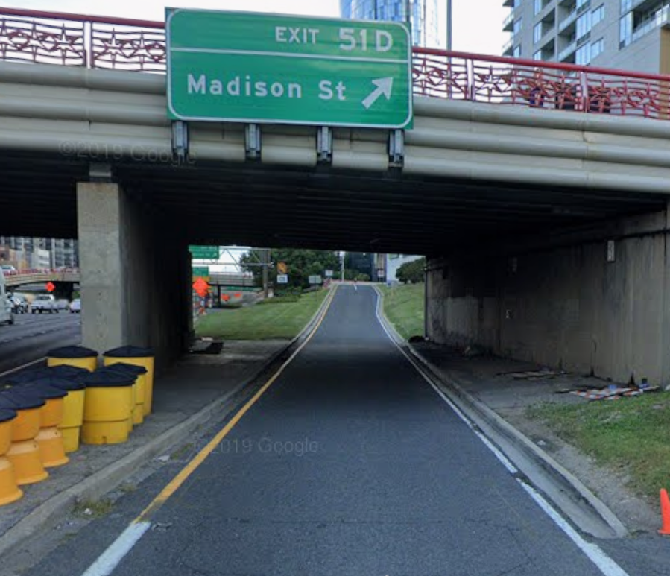
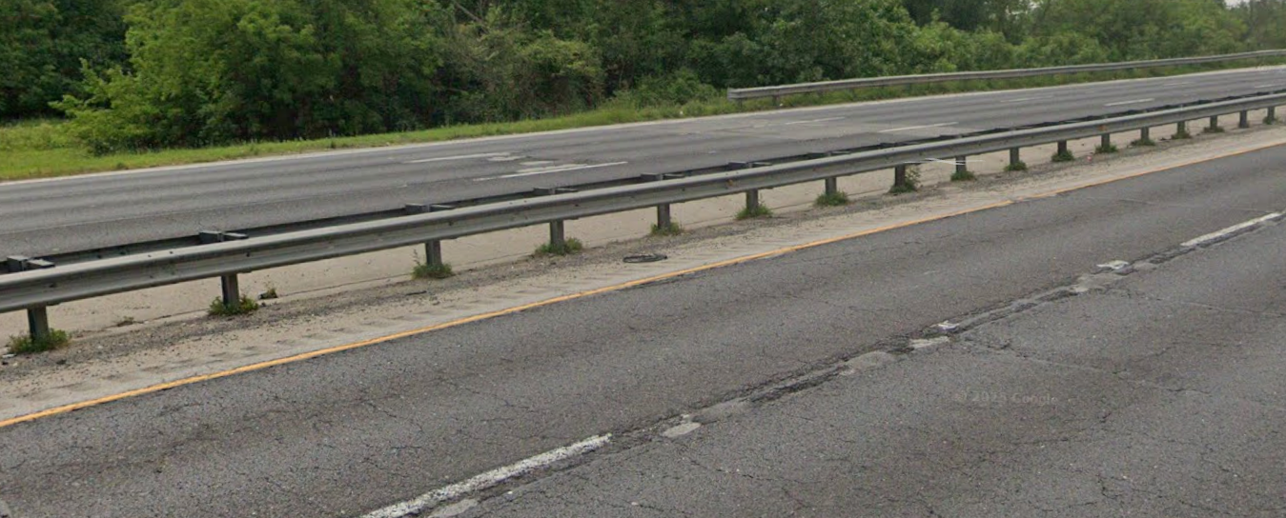
Equipment and Labor
Personnel shall be provided with hand tools to clean areas that are not accessible to sweeping equipment.
Areas Included in Contract
Hand Laboring
Aggregate or stone shoulders, regardless of width
Under and behind all guardrails, attenuators, regardless of surface type.
All medians regardless of surface type.
Drainage swales, roadway runoff areas, various drainage structures, and sidewalks
Curb lines, where compacted dirt must be loosened
Required for removing all rubbish, debris, and litter, including but not limited to:
Sand, Rocks, Dirt, Gravel, and Concrete.
Wood, Tree limbs, and Weeds.
Animal Carcasses, and Garbage

Slide 6
Traffic Control
The Contractor shall request and gain approval from the Illinois Department of Transportation's Expressway Traffic Operations Engineer at www.idotlcs.com twenty-four (24) hours in advance of all daily lane, ramp and shoulder closures and 7 days in advance of all permanent and weekend closures on all Freeways and/or Expressways in District One. This advance notification is calculated based on workweek of Monday through Friday and shall not include weekends or Holidays.
Expressway Daytime Cleaning
Bishop Ford/Kingery Expressway Interstate 94 from Cottage Grove Avenue to the Indiana State line excluding northbound and southbound left hand side from Cottage Grove Avenue to 171st St., Illinois 394 from Interstate 94 to Goodenow Rd., the entire Stony Island Avenue - 103rd Street Interchange. Interstate 80 from Interstate 94 to Interstate 294 and all accident investigation sites.
Stevenson Expressway Interstate 55 (Stevenson Expressway) from Lake Shore Dr. to the Cook – DuPage County Line (County Line Rd.), including First Avenue, from 43rd Street to Archer Avenue, the ramps to and from Joliet Rd from Interstate 55 to Wolf Rd, the ramps from northbound Interstate 55 to northbound Interstate 294 Tollway and from southbound Interstate 294 Tollway to northbound Interstate 55 (Limits of cleaning on these ramps are from Interstate 55 to the first painted gore south of the bridge over Joliet Rd), and all accident investigation sites, excluding the entire Stevenson – Dan Ryan Interchange.
Eisenhower Expressway Interstate 290 and its appurtenances from Wells St. to Austin Blvd. in its entirety, from Austin Blvd. to IL-83 right hand side and all ramps, the eastbound collector-distributor lane and ramps at the U.S. 12/20/45 (Mannheim Rd.) interchange and westbound to Roosevelt Rd. on its extension.
I-290 Extension from Illinois 83 to Interstate 90 Jane Addams Tollway, Illinois 53 from Interstate 90 Jane Addams Tollway to Lake Cook Road including I-355 from I-290 to Army Trail Road, All Ramps onto IL 390.
I-55 Expressway Interstate 55 from Cook - DuPage county line (County Line Rd.) to I-355, I & M Canal to Will – Grundy county line (Reed Rd.) in its entirety, including all ramps and the entire I-55 - I-80 interchange, all accident investigation sites, Blodgett Rd. from Kelly Rd. to West Frontage Rd., Arsenal Rd. from the East Frontage Rd. to Elwood International Port Rd. (Baseline Rd.), and the West Frontage Rd. Connector from Arsenal Rd. to the southbound entrance ramp.
I-57 Expressway Interstate 57 from Halsted Street to The Will-Kankakee County Line, in its entirety including the entire I-57 – I-80 Interchange and all accident investigation sites, and from Interstate 57 to Interstate 94 Dan Ryan right hand side only.

Slide 7
Traffic Control Continued
I-80 Expressway Interstate 80 from Interstate 294 Tri-State Tollway/Interstate I-294 to US 30 and all ramps, including the ramp from eastbound Interstate 80 to northbound Interstate 294 and from southbound Interstate 294 to westbound Interstate 80.
Kennedy Expressway All Ramps on Interstate 90/94 from Ogden Ave to Interstate 90/94 Junction at Edens Expressway, Interstate 90 from Interstate 90/94 Junction at Edens Expressway to Interstate 90/190 Junction, and Interstate 190 from Interstate 90/190 Junction to the East Limits of O’Hare International Airport (Bessie Coleman Rd) unless ramps are too narrow to allow traffic to pass sweeping crew.
Dan Ryan Expressway Interstate 94 from Cottage Grove Ave to 31st St right hand side of both local and express lanes and all ramps except slip ramps between local and express lanes and any ramps too narrow to allow traffic to pass sweeping crew.
Edens Expressway Interstate 94 from Montrose to Dundee Road and US 41 from Dundee Road to Route 22, including two ramps at Clavey Road, two ramps at West Park Avenue, four ramps at Deerpath Road and the entire US 41/Deerfield Road interchange. Also included is Tower Road from Edens Expressway to Forestway Drive.

Slide 8
Expressway lane closures allowable hours
IDOT ALLOWABLE LANE CLOSURE HOURS DAY TIME
BISHOP FORD | I-80 TO 107TH | INBOUND | ST/MO | 10:00 AM | TO | 2:00 PM
 |  | OUTBOUND | ST/MO | 8:30 AM | TO | 12:30 PM
 | DOLTON TO 107TH | INBOUND | MO | 10:00 AM | TO | 2:00 PM
 |  | OUTBOUND | MO | 8:30 AM | TO | 12:30 PM
 | 107TH TO DAN RYAN | INBOUND | MO | 10:30 AM | TO | 1:00 PM
 |  | OUTBOUND | MO | 9:00 AM | TO | 11:59 AM
IL-396/ DANVILLE XTN | I-80 TO SAUK TRAIL | INBOUND | MO | 10:00 AM | TO | 3:00 PM
 |  | OUTBOUND | MO | 8:30 AM | TO | 2:00 PM
I-80/94 (KINGERY) | INDIANA TO IL-394 | INBOUND | MO | 9:30 AM | TO | 2:30 PM
 |  | OUTBOUND | MO | 9:00 AM | TO | 2:00 PM
STEVENSON | COUNTY LINE TO DAN RYAN | INBOUND | MO | 10:00 AM | TO | 2:00 AM
 |  | OUTBOUND | MO | 9:00 AM | TO | 1:00 PM
 | DAN RYAN TO LAKE SHORE DRIVE | INBOUND | MO | 10:00 AM | TO | 2:30 PM
 |  | OUTBOUND | MO | 9:00 AM | TO | 2:00 PM
EISENHOWER | IL-83 TO I-294 | INBOUND | MO | 9:30 AM | TO | 2:00 PM
 |  | OUTBOUND | MO | 9:00 AM | TO | 1:30 PM
 | WOLF TO CENTRAL | INBOUND | MO | 11:30 AM | TO | 2:30 PM
 |  | OUTBOUND | MO | 9:00 AM | TO | 12:00 PM
 | CENTRAL TO WELLS | INBOUND | MO | 11:00 AM | TO | 2:30 PM
 |  | OUTBOUND | MO | 9:00 AM | TO | 1:00 PM
I-290 EXTENSION | I-90 TO I-355 | INBOUND | MO | 9:30 AM | TO | 2:30 PM
 |  | OUTBOUND | MO | 9:30 AM | TO | 2:30 PM
 | I-355 TO IL-83 | INBOUND | MO | 9:30 AM | TO | 2:30 PM
 |  | OUTBOUND | MO | 9:00 AM | TO | 2:00 PM
IL-53 | LAKE COOK TO I-90 | INBOUND | MO | 10:00 AM | TO | 2:00 AM
 |  | OUTBOUND | MO | 1:30 PM | TO | 1:30 PM
I-355 | ARMY TRAIL TO I-290 | INBOUND | MO | 10:00 AM | TO | 2:30 PM
 |  | OUTBOUND | MO | 10:00 AM | TO | 2:30 PM

Slide 9
Expressway lane closures allowable hours
I-55 | REED RD TO LORENZO | INBOUND | MO | 8:30 AM | TO | 3:00 PM
 |  | OUTBOUND | MO | 8:30 AM | TO | 3:00 PM
 | LORENZO RD TO I-80 | INBOUND | MO | 9:00 AM | TO | 2:00 PM
 |  | OUTBOUND | MO | 8:30 PM | TO | 1:30 PM
 | I-80 TO WEBER | INBOUND | MO | 9:00 AM | TO | 2:30 PM
 |  | OUTBOUND | MO | 10:00 AM | TO | 2:00 PM
 | WEBER TO COUNTY LINE RD | INBOUND | MO | 10:00 AM | TO | 2:00 PM
 |  | OUTBOUND | MO | 9:00 AM | TO | 1:00 PM
I-80 | KENDALL CO TO LARKIN | INBOUND | MO | 9:30 AM | TO | 2:00 PM
 |  | OUTBOUND | MO | 8:30 AM | TO | 1:30 PM
 | LARKIN TO US-30 | INBOUND | MO | 9:30 AM | TO | 1:30 PM
 |  | OUTBOUND | MO | 9:30 AM | TO | 1:30 PM
 | US-30 TO IL-43 | INBOUND | MO | 9:00 AM | TO | 3:00 PM
 |  | OUTBOUND | MO | 9:00 AM | TO | 3:00 PM
 | IL-43 TO I-294 | INBOUND | MO | 9:00 AM | TO | 3:00 PM
 |  | OUTBOUND | MO | 9:00 AM | TO | 3:00 PM
KENNEDY | E.RIVER RD TO MONTROSE | INBOUND | MO | 11:00 AM | TO | 2:00 PM
 |  | OUTBOUND | MO | 10:00 AM | TO | 1:00 PM
 | MONTROSE TO OHIO | INBOUND | MO | 10:00 AM | TO | 1:00 PM
 |  | OUTBOUND | MO | 11:00 AM | TO | 2:00 PM
 | I-290 TO OHIO | INBOUND | MO | 10:30 AM | TO | 2:00 PM
 |  | OUTBOUND | MO | 9:30 AM | TO | 1:00 PM
I-190 | I-190 TO OHARE | INBOUND | MO | 9:30 AM | TO | 1:00 PM
 |  | OUTBOUND | MO | 9:30 AM | TO | 1:00 PM

Slide 10
Expressway lane closures allowable hours
DAN RYAN | I-57 TO 71ST | INBOUND | MO | 10:00 AM | TO | 3:00 PM
 |  | OUTBOUND | MO | 9:00 AM | TO | 2:00 PM
 | 67TH TO 31ST (EXPRESS LANES) | INBOUND | MO | 10:00 AM | TO | 3:00 PM
 |  | OUTBOUND | MO | 8:00 AM | TO | 1:30 PM
 | 67TH TO 31ST (LOCAL LANES) | INBOUND | MO | 10:00 AM | TO | 3:00 PM
 |  | OUTBOUND | MO | 9:00 AM | TO | 2:00 PM
 | 31ST TO I-290 | INBOUND | MO | 10:00 AM | TO | 1:00 PM
 |  | OUTBOUND | MO | 10:00 AM | TO | 1:00 PM
EDENS | WEST PARK AVE TO CLAVEY | INBOUND | MO | 10:00 AM |  | 2:00 PM
 |  | OUTBOUND | MO | 10:00 AM |  | 2:00 PM
 | CLAVEY TO KENNEDY JUNCTION | INBOUND | MO | 10:00 AM | TO | 2:00 PM
 |  | OUTBOUND | MO | 9:30 PM | TO | 1:30 PM

Slide 11
Payment Schedule
When a Work Order has been completed to the satisfaction of the District a pay estimate will be put together. A meeting with the contractor will need to be set up to sign paperwork to agree on Quantities. Once all paperwork and Quantities are done a pay request will be processed.

Slide 12
Daily Schedule and Work Complete
  A daily schedule must be submitted no later than 6:30am every morning.
  A daily work complete must be submitted by 6:30am the following day.
  If a daily schedule or work complete has not been submitted, the contractor will not be allowed to work that day and will be charged with that day and will not receive a reprieve for that day if requested.
  Keep the inspector and RE in the loop through out the day. If there is a change in the location or availability of the areas to be worked on or changes in times (show up or Leaving). Its best to contact the RE and/or the inspector and inform them of the changes.

Slide 13
Safety
  All Equipment used for the purpose of Sweeping on the Expressway must have high intensity amber strobes, headlights and flasher must be on while working.
  All personnel working under this contract will be required to wear approved Flagger vest when not in a vehicle.
  At no time will any construction personnel enter the live lane of traffic.
  At no time should construction personnel walk along the live lane of traffic without the proper shoulder closure and equipment.
  Before any Work Orders will be issued, an inspection of safety equipment, including signs, cones, strobes and vest will be conducted. If everything meets the minimum requirements, we will proceed with issuing Work Orders for the projects.

